Slide 1
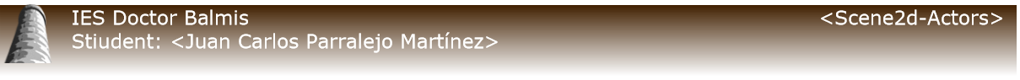
Scene2D
Actors

Slide 2
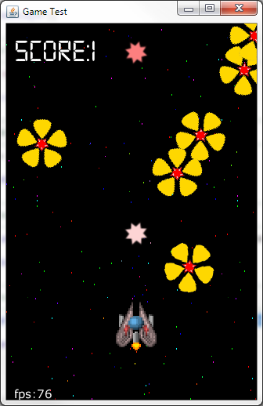
What is Scene2D.
Is a 2D scene graph for building applications and UIs using a hierarchy of actors that provides the following features:
Rotation and scale of a group is applied to all child actors.
Simplified 2D drawing via SpriteBatch.
Hit detection of rotated and scaled actors.
Routing of input and other events to the appropriate actor.

Slide 3
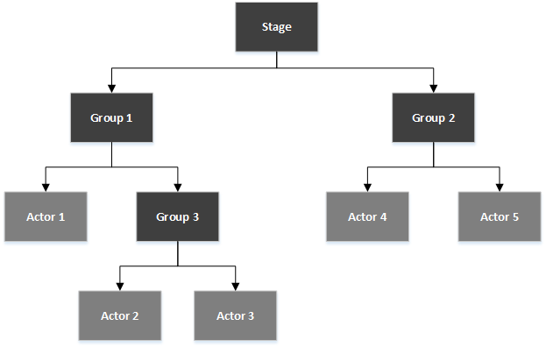
What is Scene2D.
Scene2d has three classes at its core:
The Stage class has a camera, SpriteBatch, and a root group and handles drawing the actors and distributing input events.
The Group class is an actor that may have child actors.
The Actor class is a node in the graph which has a position, rectangular size, origin, scale, rotation, and color.

Slide 4
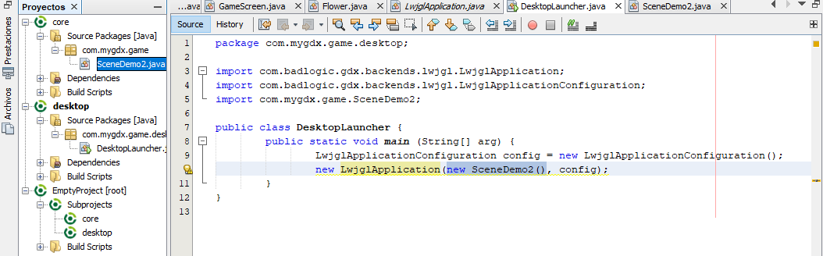
2. Explain in code
In this example we're going to create the the class that contains Scene class as the main of the core.

Slide 5
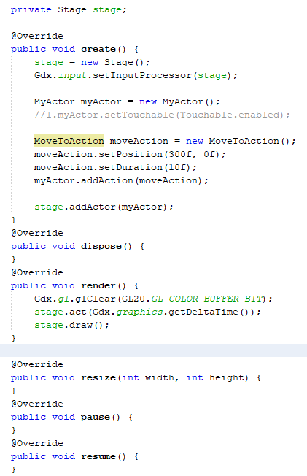
2.1. Scene
Create method:
  Create Stage object.
  Create actions class and assign values:
    MoveToAction
    RotateToAction
    ScaleToAction
  Add action in Stage.

Slide 6
2.1. Scene
Render method:
  Assign the background color
  Assign the time since the previous frame.
  draw the frame

Slide 7
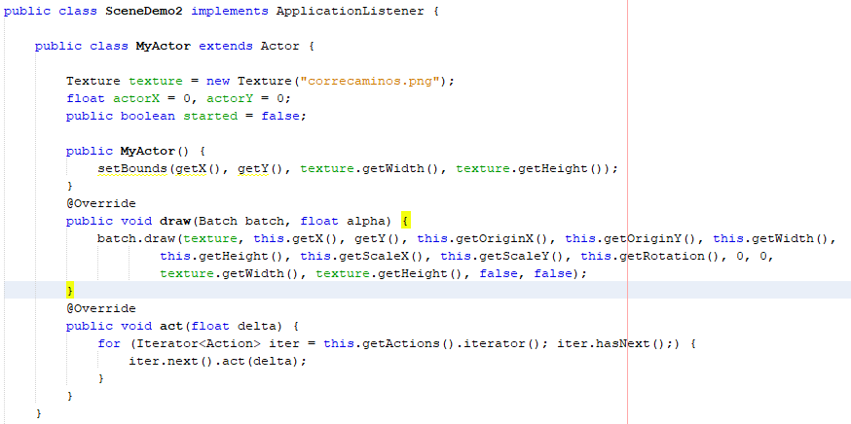
2.2. Actor
In the main class i create an Actor class.
Create a texture object
Constructor:
  Assign the size
  Assign initial position
Draw method
  Assign parameters for actor
Act Method
  Run the actions created in Scene

